Slide 1
Exploring a Multi-Layer and Multi Optimized Approach for classifying Food Images using Faster RCNN
Internal Guide: Presented by:
Prof Ms Shubhangi Mahule P Shekhar Reddy 18AG1A05G3
Maseeha Naaz 18AG1A05F3
G Rajesh 18AG1A05E2
V Naresh 19AG5A0518

Slide 2
INTRODUCTION
As people are becoming increasingly aware of the importance of a healthy diet, the need for automatic food recognition systems has arisen. Not only can such systems provide the automatic recognition of food, but they can also enable an estimation of their nutritional values, making them especially useful for dietary assessment and planning, which is applicable for patients with different dietary restrictions, as well as for healthy individuals by preventing nutrition-related conditions.
The problem of food image detection and recognition is challenging due to the nature of meal that every individual has. Foods are typically deformable objects, which makes the process of defining their structure difficult.

Slide 3
We approach this problem using deep neural networks. Deep learning alleviates this as it allows computational models composed of multiple processing layers to automatically learn these features and represent the input data with them.
Nutrition [Calcium, Vitamins, Fat, Protein, Carbohydrates] value measurement based on the Regions of interest in images.

Slide 4
OBJECTIVE
The main theme of our research is to develop computer-aided technical solutions to detect the type of meal image and to enhance and improve the accuracy of current measurements of dietary intake such as amount of Calories in a meal for the prevention and treatment of diet-related chronic diseases such as obesity, diabetes etc.,

Slide 5
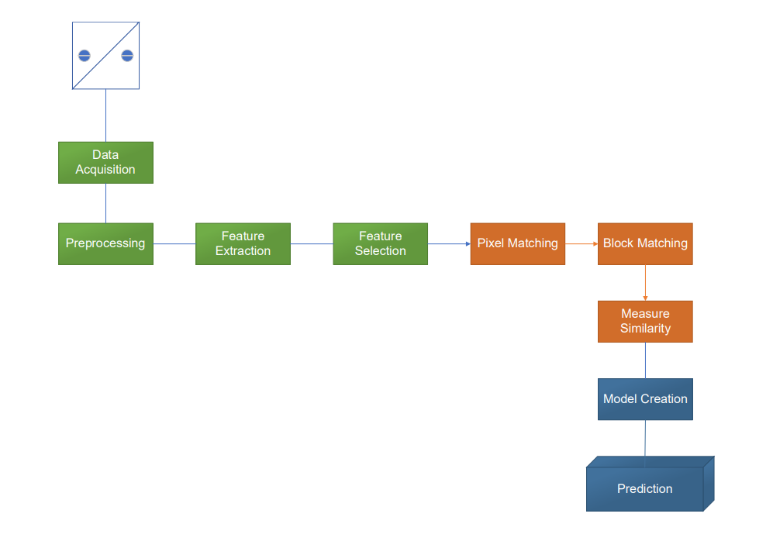
ARCHITECTURE DESIGN

Slide 6
System Requirement Specifications
Hardware requirements:
RAM : 2 GB or higher
Processor : Intel Core i3 or higher
Software requirements:
Operating System : Linux, Windows, Mac os
IDE : Google Colab or jupyter lab or Anaconda
Frame Work : Roboflow (for customization data preprocessing)

Slide 7
ALGORITHM
The model is build on RPN and CNN which stands for Faster RCNN.
Faster RCNN is an object detection architecture that uses convolution neural networks like YOLO (You Look Only Once) and SSD ( Single Shot Detector).
Faster RCNN is composed of 3 parts
Part 1 : Convolutional networks
Part 2 : Region Proposal Network (RPN)
Part 3 : ROI pooling

Slide 8
Convolutional Layers
In this layers we train filters to extract the appropriate features the image
We compute convolution by sliding filter all along our input image and the result is a two dimension matrix called feature map.
By filtering all possible slidings the fully convoluted layer will form which is a output layer.

Slide 9
Region Proposal Network
The R-CNN and Fast R-CNN models depend on the Selective Search algorithm for generating region proposals.
The Faster RCNN has a network called region proposal network (RPN) that can produce the region proposals.
To generate these so called “proposals” for the region where the object lies, a small network is slide over a convolutional feature map that is the output by the last convolutional layer.
The concept of anchors box is evolved to represent that small network slide (object).
The anchors are formed from any image by two parameters:
a. Scale = size of image
b. aspect ratio = width of image / height of image

Slide 10
In RPN the deveopers choice is to take 3 scale and 3 aspect ratio to form a Proposals of each pixel (3*3=9) .
For the whole image, number of anchors is W*H*K.

Slide 11
ROI Pooling
The feature map from the last convolutional layer is fed to an ROI Pooling layer.
The reason is to extract a fixed-length feature vector from each region proposal.
he ROI Pooling layer works by splitting each region proposal into a grid of cells.
The max pooling operation is applied to each cell in the grid to return a single value. (takes the largest value in the grid)

Slide 12
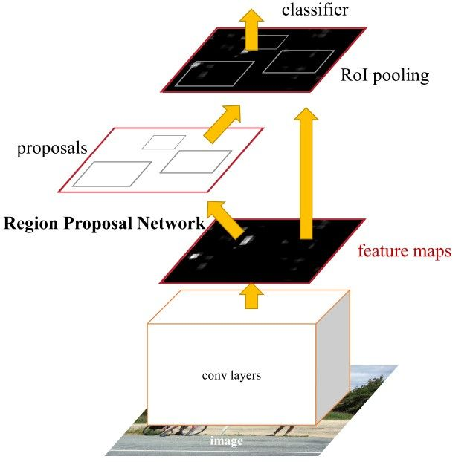
Algorithm Architecture

Slide 13
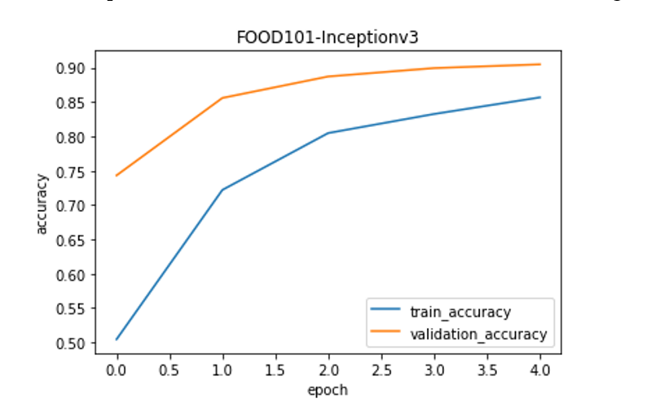
GRAPH- Train vs Validation Accuracy

Slide 14
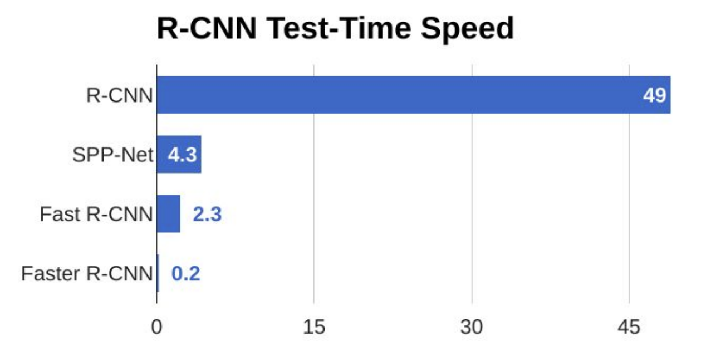
GRAPH- Test time speed variations

Slide 15
CONCLUSION
It describes an image classification system for identifying food items in images of eating occasions. Automatic identification of food items in an image is not an easy problem. We fully understand that we will not be able to recognize every kind of food. We are continuing to refine and develop the system to increase its accuracy and usability by exploring contextual information in addition to visual characteristics.

Slide 16
REFERENCES
[1] Deep Food: Food Image Analysis and Dietary Assessment via Deep Model , LANDU JIANG (Member, IEEE), BOJIA QIU , XUE LIU , (Fellow, IEEE), CHENXI HUANG, AND KUNHUI LIN 1School of Informatics, Xiamen University, Xiamen 361005, China.
[2] Colorado Clinical and Translational Sciences Institute. (2014). Most Common Dietary Assessment Methods. [Online]. Available: https://cctsi. cuanschutz.edu/
[3] K. Aizawa, Y. Maruyama, H. Li, and C. Morikawa, ‘‘Food balance estimation by using personal dietary tendencies in a multimedia food log,’’ IEEE Trans. Multimedia, vol. 15, no. 8, pp. 2176–2185, Dec. 2013.

Slide 17
[4] D. Albanes, ‘‘Total calories, body weight, and tumor incidence in mice,’’ Cancer Res., vol. 47, no. 8, pp. 1887–1892, 1987.
[5] S. Ao and C. X. Ling, ‘‘Adapting new categories for food recognition with deep representation,’’ in Proc. IEEE Int. Conf. Data Mining Workshop (ICDMW), Nov. 2015, pp. 1196–1203.
[6] K. Ashton, ‘‘That ‘Internet of Things’ thing,’’ RFID J., vol. 22, no. 7, pp. 97–114, 2009.
[7] S. Belongie, J. Malik, and J. Puzicha, ‘‘Shape context: A new descriptor for shape matching and object recognition,’’ in Proc. Adv. Neural Inf. Process. Syst., 2001, pp. 831–837.
[8] Q. Bojia, Food Recognition and Nutrition Analysis Using Deep CNNs. Montreal, QC, Canada: McGill Univ., 2019.

Slide 18
ACKNOWLEDGEMENT
We would like to thank our guide Prof. Ms. Shubhangi Mahule and Soppari Kavitha for their continuous support and guidance. Due to their guidance, we completed our project successfully. Also, we are extremely grateful to Dr. M. V. VIJAYA SARADHI, Head of the Department of Computer Science and Engineering, Ace Engineering College for his support and invaluable time.

Slide 19
